Slide 1

Relational Database Design for Employee Management System
Presented by:
P. Sridhar
Batch No: 450
Innomatics Research
Labs, Dilsuknagar

Slide 2
ABOUT ME
I am PUTNALA SRIDHAR
I Completed my graduation in the stream of B.sc (MSDS) and Degree from Govt degree college of khairatabad.
Linkedin : https://www.linkedin.com/in/putnala-sridhar-067077370/
GitHub : https://github.com/putnalasridhar

Slide 3
Agenda
Business Problem
Objective
Database Design
ER Diagram and schema explanation
SQL query results with screenshots
Challenges
Final business insights and recommendations
Conclusion

Slide 4
Business Problem
Many organizations find it difficult to manage employee data properly. Employee details like job roles, salaries, qualifications, leaves, and payroll are often stored in different places or handled manually.
Because of this, companies face problems such as:
Difficulty in tracking employee records
Errors in salary and payroll processing
Poor leave management
Lack of proper reports
Time-consuming HR work

Slide 5
Objective
The objective of this project is to design and develop an Employee Management System that stores and manages employee information efficiently.
The system aims to maintain details such as job roles, salaries, qualifications, leaves, and payroll in a centralized database.
It helps in easy data access, accurate record management, and better HR decision-making.

Slide 6
Database Design
The system is designed using a relational database
Multiple tables are created to store employee data
Main tables: Employee, JobDepartment, SalaryBonus, Qualification, Leaves, Payroll
Primary keys are used to uniquely identify records
Foreign keys are used to link related tables
Cascading actions maintain data integrity
The design ensures accurate storage and easy retrieval of data.
Relationships
Job Department → Employee : One-to-Many (1:M)
Job Department → Salary Bonus : One-to-One (1:1)
Employee → Qualification : One-to-Many (1:M)
Employee → Leaves : One-to-Many (1:M)
Employee → Payroll : One-to-Many (1:M)
Leaves → Payroll : One-to-One

Slide 7
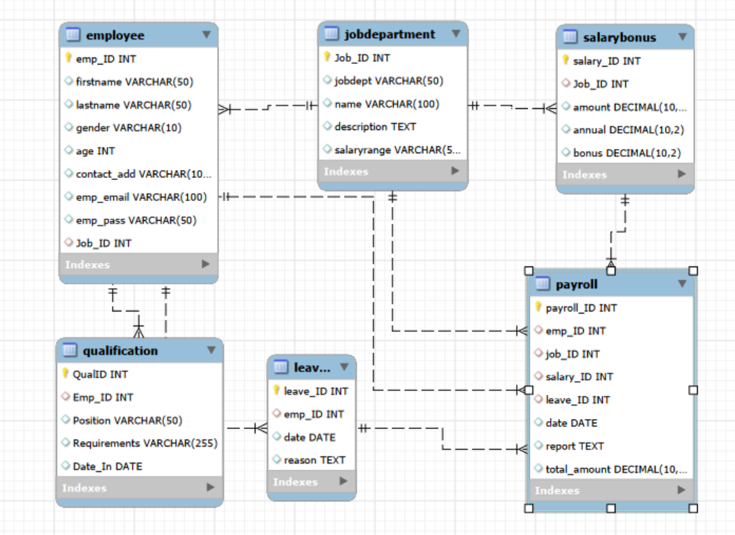
ER Diagram

Slide 8
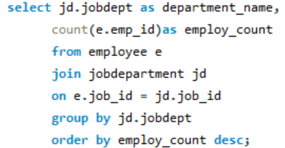
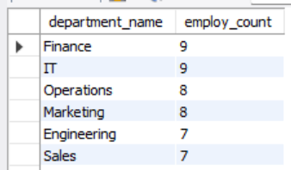
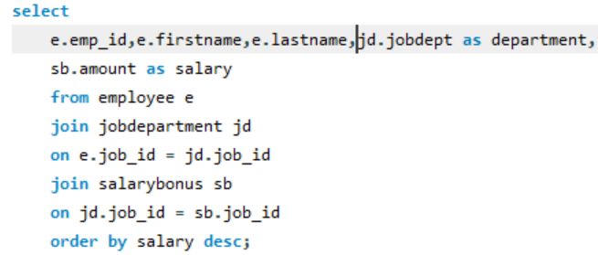
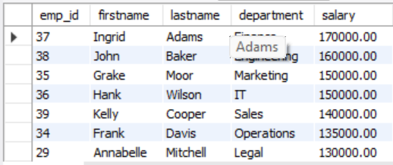
SQL Queries
1. Which departments have the highest number of employees?
2. Who are the top 5 highest-paid employees?

Slide 9
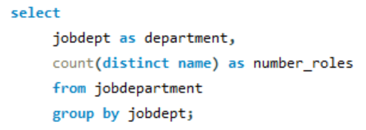
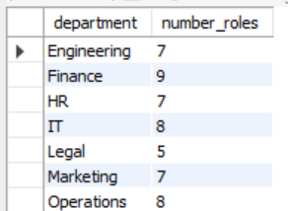
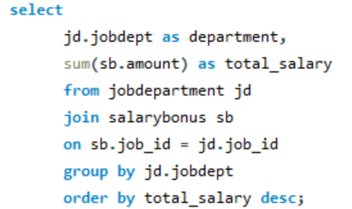
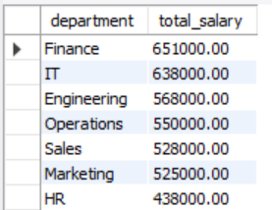
3. How many different job roles exist in each department?
4. Which departments have the highest total salary allocation?

Slide 10
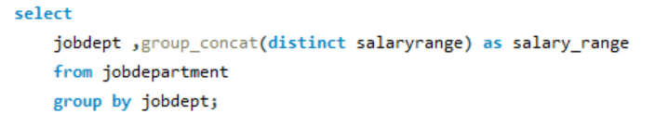
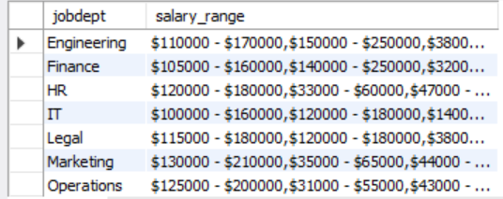
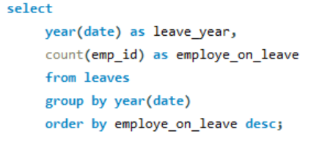

5. What is the average salary per department?
6. Which year had the most employees taking leaves?

Slide 11
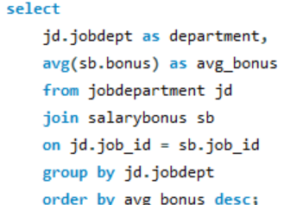
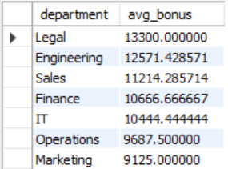
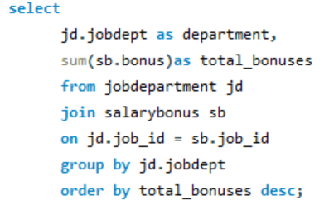
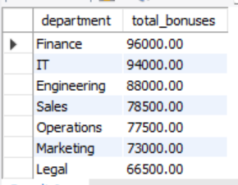
7.What is the average bonus given per department?
8. Which department receives the highest total bonuses?

Slide 12
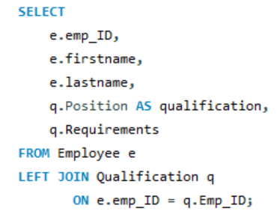
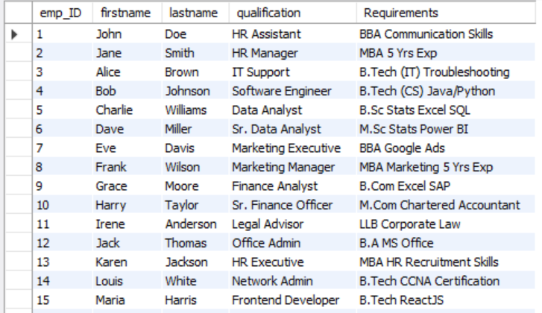
9 . List employees along with their qualifications and skills?

Slide 13
Challenges
Challenges faced include defining correct table relationships, using foreign keys properly, and maintaining data consistency with cascading actions.
Writing complex joins for payroll and leave reports was difficult.
Ensuring correct date formats and preventing duplicate records (like email) were also key challenges.

Slide 14
Key Insights
Employee data can be managed in one centralized system. this improves data access and accuracy.
Departments with more employees were identified. it helps in workforce planning.
Salary and bonus distribution became clear. financial allocation is easy to understand.
Leave patterns of employees were analyzed. it supports attendance monitoring.
Payroll expenses were calculated easily budget control becomes better.
Qualifications and skills tracking improved decision-making.
HR planning becomes more effective.
Recommendations
❖ Provide training programs to enhance employee skills and qualifications.
❖ Monitor leave trends to improve workforce planning and productivity.
❖ Optimize bonus and salary structures for fair, performance-based compensation.

Slide 15
Conclusion
The Employee Management System helps store and manage all employee data in one place.
It improves payroll processing, leave tracking, and qualification management.
The system supports accurate reports, better HR decisions, and efficient organizational operations.

Slide 17

THANK YOU

